Slide 1
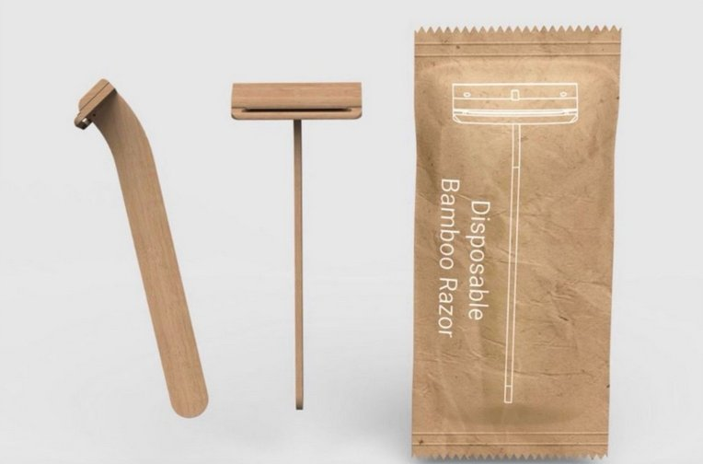
Nomad
Bamboo Disposable Razor
The world's first fully biodegradable,
plastic-free disposable razor.
Confidential — For Brand & Distribution Partners

Slide 2
The Problem With Plastic Razors
2B+
32%
127
Plastic Razors
Countries
discarded every year
in the US alone
of all plastic waste
ends up in the ocean
have enacted single-use
plastic regulations
Source: US EPA
Source: US EPA
Source: UKHI / Wikipedia, 2024
Plastic razors are made from mixed materials — plastic, rubber and metal — making them virtually impossible to recycle. They persist in landfill and ocean environments for hundreds of years, breaking down into microplastics.

Slide 3
A Global Regulatory Wave Is Coming
Governments worldwide are restricting single-use and low-use plastic products. Brands relying on plastic disposables face growing regulatory risk — and a narrowing window to act.
2019
European Union Single-Use Plastics Directive bans a wide range of plastic products across all 27 member states. Updated in 2024 to add further items.
2022
India Nationwide ban on single-use plastics enacted July 2022; government closed over 1,200 plastic factories during enforcement.
2024
Canada — G7 First First G7 nation to fully ban single-use plastics — bags, cutlery, stir sticks and food containers. Canadians discard 3 million tonnes of plastic annually, less than 10% recycled.
2025–27
Global Trajectory UN projects 90+ countries will have single-use plastic bans by 2027. An Ipsos/WWF poll across 32 countries found 85% of consumers support a global ban.
Sources: EU Directive 2019/904; UKHI Global Plastic Regulations 2025; WWF/Ipsos April 2024; sydlerelectro.co.in

Slide 4
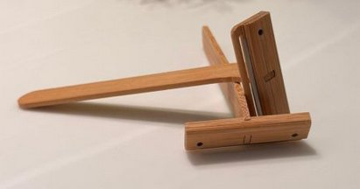
Introducing the Nomad Bamboo Razor
🌿
100% Biodegradable
Fully breaks down in landfill or ocean — no microplastics, no persistent waste left behind.
🎋
Specially Pressed Bamboo
Engineered bamboo handle with structural strength matching or exceeding traditional plastic.
✦
Stainless Steel Blade
Premium shave quality — no compromise on performance for your end consumer.
📦
~500,000 Units / 20ft Container
Bulk-packed for freight efficiency — competitive landed cost at volume.
World's first fully plastic-free, biodegradable disposable razor.

Slide 5
Naturally Hygienic by Material
Beyond eliminating plastic waste, the Nomad's solid bamboo handle offers a hygiene advantage that conventional plastic, rubber and metal razors cannot. Peer-reviewed studies show natural bamboo material carries compounds that inhibit bacterial growth — a meaningful benefit for healthcare, hospitality and high-traffic washroom settings.
Up to
95%
E. coli
+ S. aureus
Lignin
Bacterial Reduction
Inhibited In Testing
Natural Mechanism
Natural bamboo material reduced bacteria by 8–95% across tested species in laboratory study.
Solid bamboo powder showed effective antibacterial action against both bacteria in peer-reviewed tests.
Phenolic and lignin compounds occurring naturally in bamboo — no added chemicals or coatings.
A complementary material benefit — not a substitute for clinical disinfection. The stainless steel blade delivers the shave; the bamboo handle simply starts cleaner than plastic.
Source: Ramful et al., Antibiotics (2022); Afrin et al., BJSTR (2020). Claims refer to natural bamboo material; processing can alter properties (US FTC).

Slide 6
Make It Yours — Brand Customisation
The Nomad is designed to carry your brand. Two complementary customisation options let you create a fully branded, shelf-ready product — with zero plastic at any point in the chain.
✦
🌿
Laser-Etched Branding
Eco Paper Pouch Packaging
Brand name, logo or artwork etched directly into the bamboo handle
Standard packaging is a kraft paper pouch — fully compostable, plastic-free
Permanent, chemical-free process — no inks, no plastics, no coatings
Custom print available: brand colours, logo, product name and regulatory text
Precise, premium finish that reinforces eco credentials
Printed with eco-friendly water-based inks on recycled or FSC-certified stock
Suitable for wordmarks, logos and simple graphic elements
Ready for retail shelf, hospitality amenity kits or e-commerce fulfilment
Both options available independently or together. MOQs and artwork specs available on request.

Slide 7
THE OPPORTUNITY
Be First
To Market.
First-to-market advantage as plastic disposables face global legislation
Drop-in replacement for existing plastic SKUs — no consumer behaviour change
Regulatory compliance built in — future-proof your personal care range
Pricing on request — significant breaks for large-volume orders
Private label & white-label supply available
[Insert your contact details to request pricing & samples]

